Slide 1



Slide 2
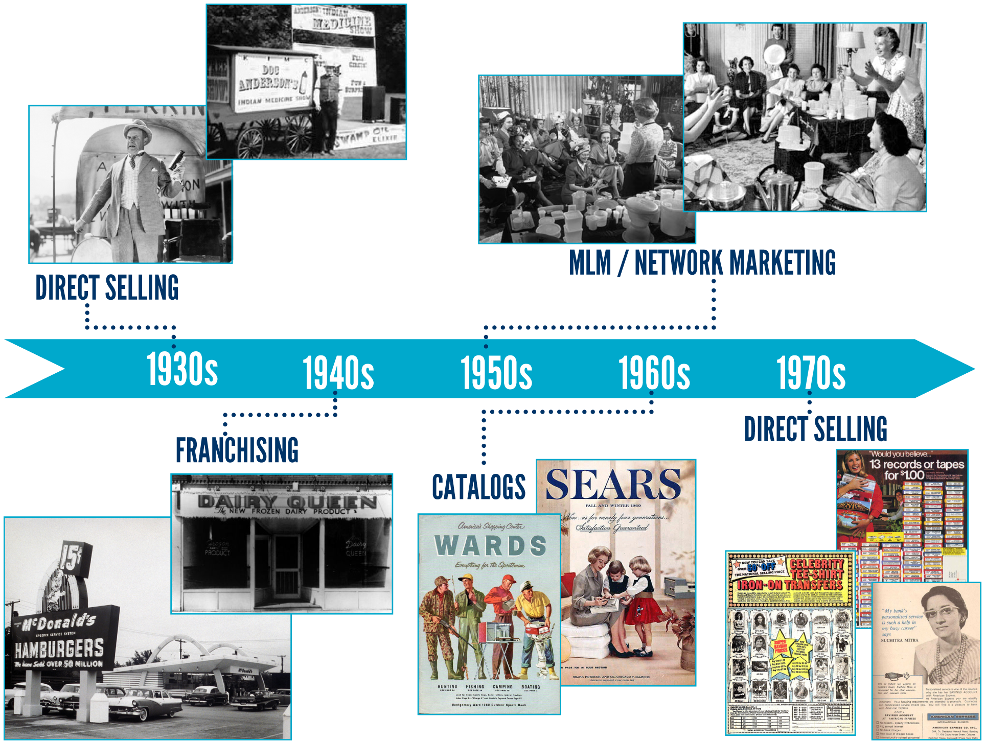
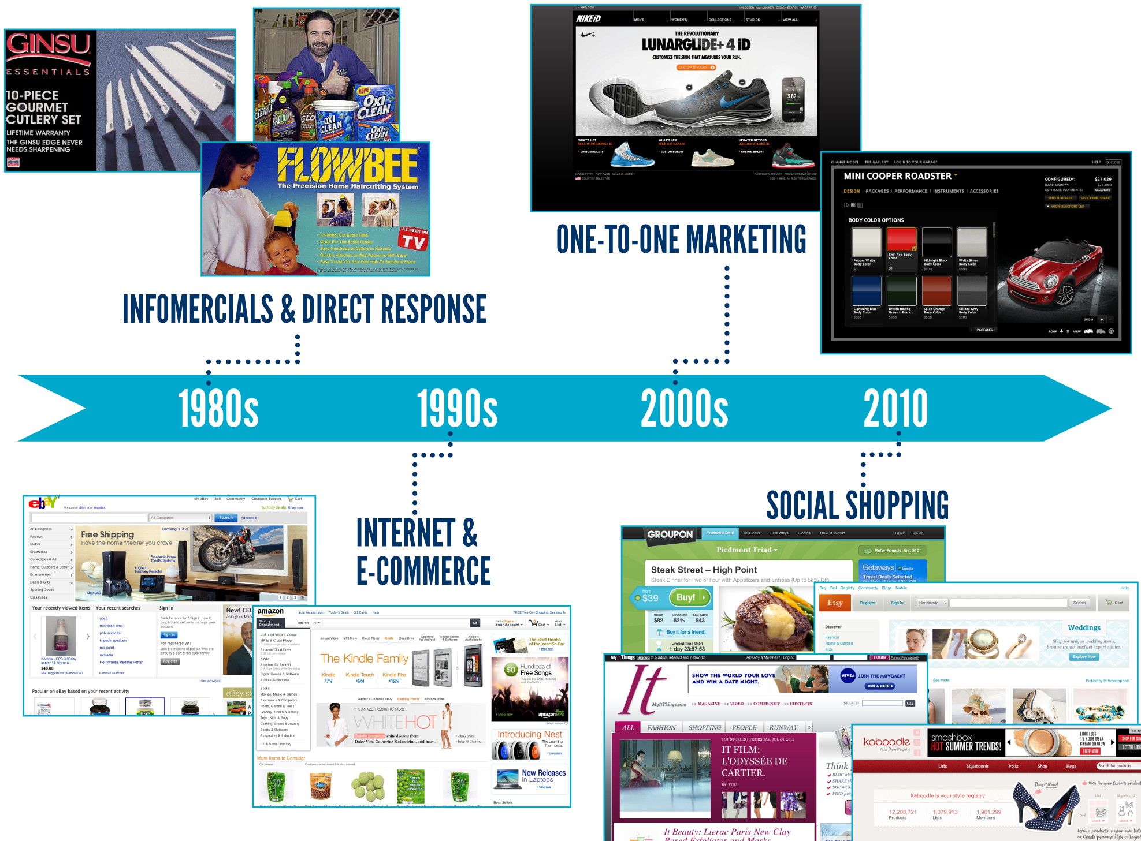
每隔10至20年，一套新的行銷系統就會出現
一對一行銷
電視購物
直銷
多層次傳銷
互聯網與電子商務
社交購物
直接信函
連鎖
目錄行銷

Slide 3

不久前的美安公司
目標聲明
提供按一般人可實際做到的事情建立的強大事業機會
Yesteryear’s Market America
MISSION STATEMENT
To provide the most powerful business opportunity based on what the average person can actually and realistically achieve.

Slide 4
願景
The Vision
業務模式按一般人所做到的事情來建立…
零售系統而非購物系統…產品主導
組織架構營造了共同的經濟體系，目標是讓人人都成功
佣金計劃減低／消除了組織內的競爭
業務不單能持續創造盈利，並能穩健發展！
Business model that was based on what the average individual could actually and realistically do…
Selling system rather than a buying system… Product Driven
Organizational structure that created a vested economic interest in the success of everyone.
Compensation plan that minimized / eliminated competition within the organization.
Business that was not only profitable, But Stable!

Slide 5
願景
The Vision
靈活而非靜止的業務
業務可由下一代承繼，並可承傳至一代接一代
Business that was Dynamic NOT Static.
Business that could be willed and passed down
generation to generation.

Slide 6

嶄新的公司
A NEW COMPANY
美安公司是一間產品分銷及互聯網銷售公司，專門從事一對一行銷與社交購物。
Market America is a Product Brokerage and Internet Marketing Company specializing in One-to-One Marketing and Social Shopping.

Slide 7
Today’s Market America MISSION STATEMENT
今日的美安公司
目標聲明
為有心創業的人士提供系統，透過永續收入創造財富，同時為全球的消費者提出更好的購物方式。透過革新的科技與人才動力，我們正在開創未來的新經濟。
To provide a system for entrepreneurs to create wealth through an ongoing income, while providing consumers worldwide with a better way to shop. Through revolutionary technology and the power of people, we are creating the economy of the future.

Slide 8
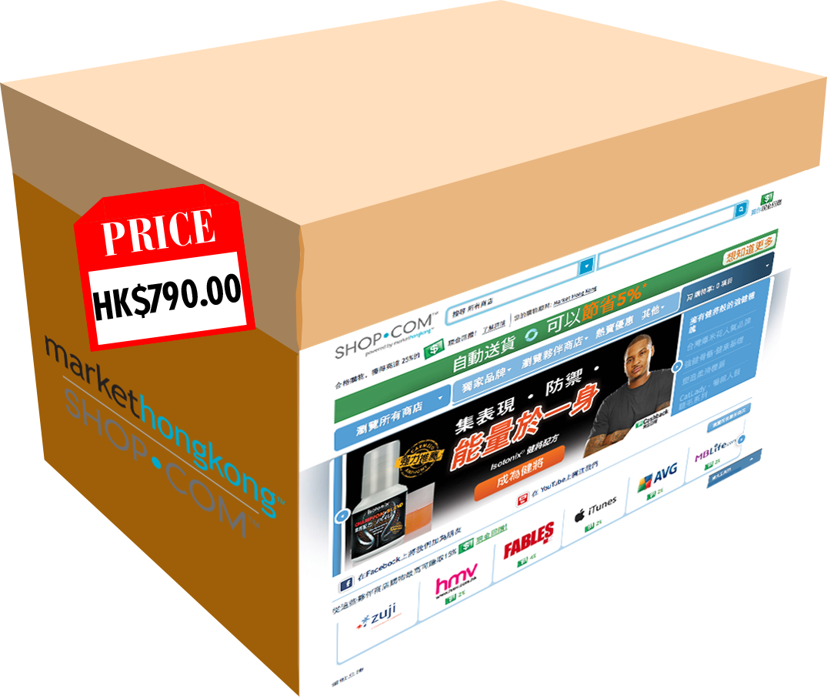

Slide 9

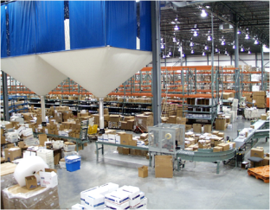

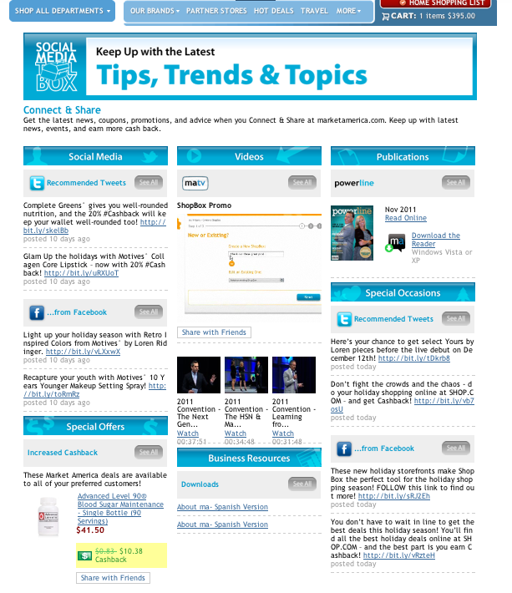
熱賣優惠
HOT DEALS
消費即賺
PAID TO SHOP
電子商務
ECOMMERCE
電子禮物-專利功能！
EGIFTS - PATENDED!
現金回贈
CASHBACK
品牌形象
Branding
營運中心
FULFILLMENT CENTER
訂單追蹤
Order Tracking
自動送貨及購物年金
AUTO SHIP &
SHOPPING ANNUITY
2500項美安產品
2500 ma products

Slide 10
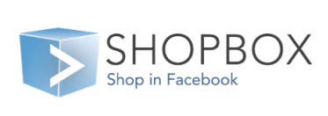
綜合熱賣優惠
AGGREGATED HOT DEALS PUSHED
消費即賺
PAID TO SHOP
流動信用卡付款
Mobile Payment Credit Card Swipe
經銷商招募網站
Distributor Recruiting Sites
電子商務
ECOMMERCE
現金回贈
CASHBACK
品牌形象
Branding
電子禮物-專利功能！
EGIFTS - PATENDED!
超過300個傳媒報導併購消息
Acquisition in News
Coverage in over
300 media outlets
搜尋引擎優化及搜尋引擎行銷SEO & SEM
500萬品牌-仍在增加
5 million Brands & Growing
自動送貨及購物年金
AUTO SHIP &
TRANSFER BUYING ANNUITY
營運中心
FULFILLMENT CENTER
3000項美安產品
3000 ma products
訂單追蹤
Order Tracking
顧客篩選及保障
Customer Screening and Protection
科技
Technology
流動應用程式
MOBILE APPLICATIONS
營運中心
Aggregated Coupons
免運費
FREE SHIPPING

Slide 11





包括甚麼？
What’s Included?
$
垂直行銷
無需僱用人員運作
透過其他事業經營者擴大分銷
賺取永續收入
你透過分銷賺$
不會分薄他人利潤
每個SHOP.COM網站擁有人(UFO)享有：
顧客經篩選 + 受保障
顧客個人檔案、記錄、追蹤
顧客為UFO所有
使用所有後台辦公室功能
$
$
Vertical Marketing
Do not need employees to run
Expand distribution through other owners
Credited Residual Income
You make $ on Distribution thread
No reduction in profit to others
Each SHOP.COM Site owner (UFO)gets:
Customers are screened + Protected
Customer Profiles, Records, Tracking
UFO owns the customer
Complete back
office access
$
$
$
$
$
$

Slide 12


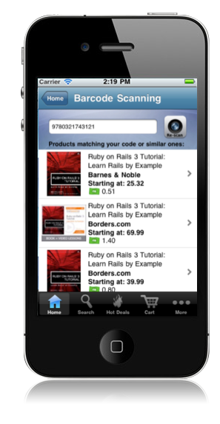
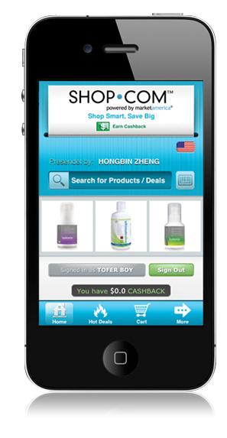
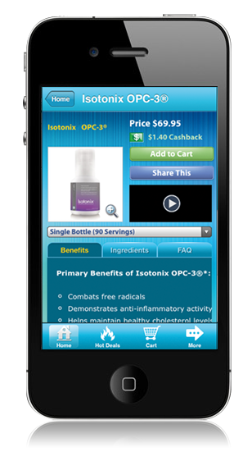
科技與應用程式
轉消費為收入
家居顧問
Home Advisor
流動科技
Mobile technology
條碼掃瞄
Barcode
Scanning
流動網站
Mobile Site
產品資訊
Product
Information
ShopBuddy

Slide 13


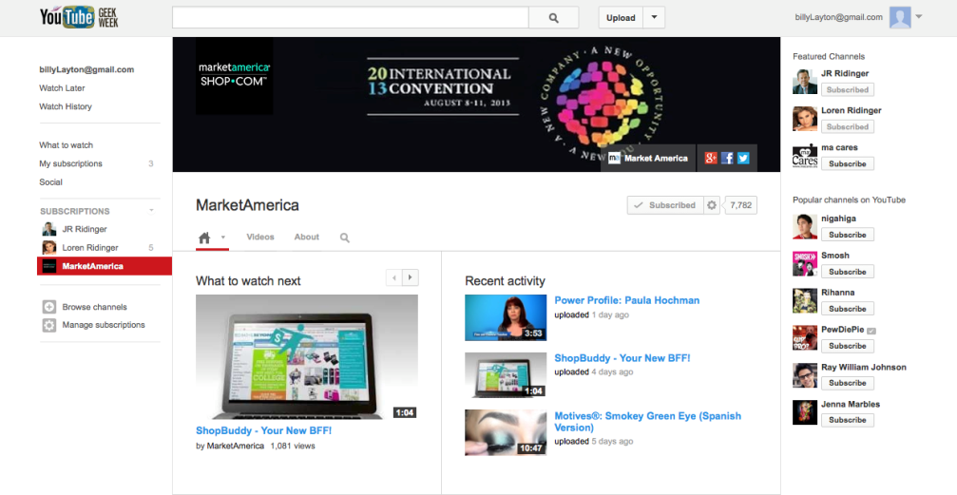
新的
NEW
新的
NEW
新的
NEW
新的
NEW
新的
NEW

Slide 14

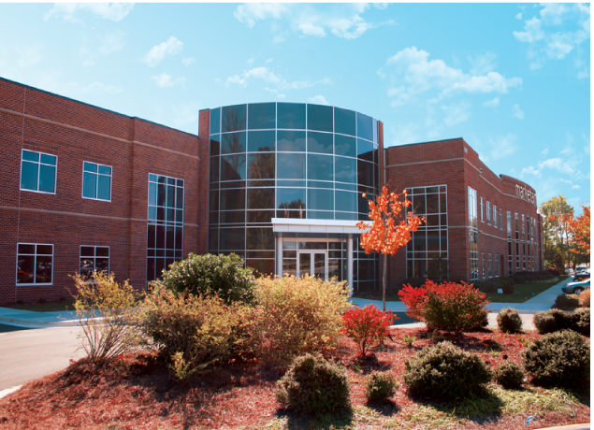
舊有的已經煥然一新
What was old is NEW
舊的
Old
新的
NEW

Slide 15

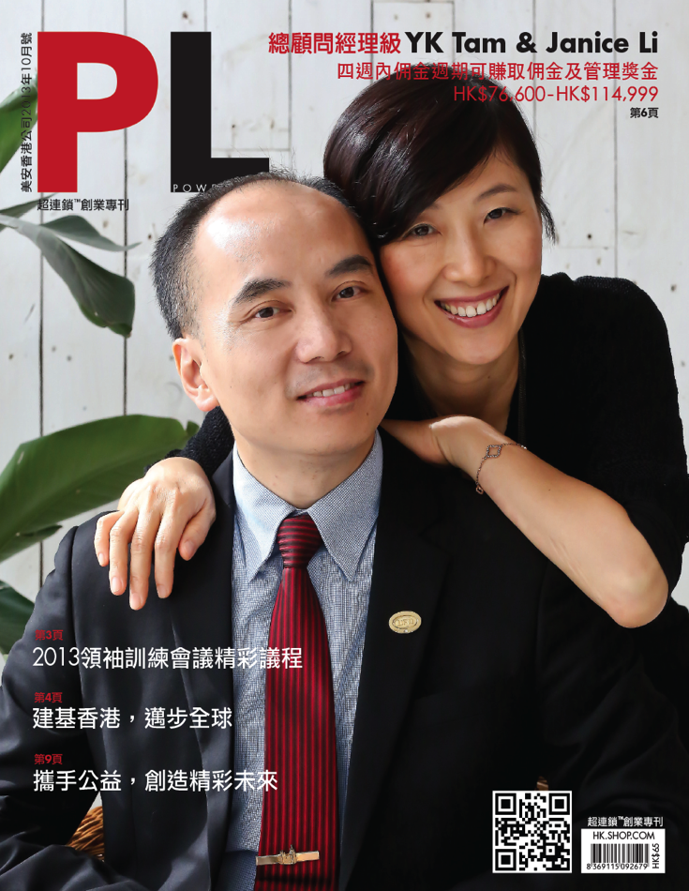
舊有的已經煥然一新
What was old is NEW
舊的
Old
新的
NEW

Slide 16


產品與服務
Products & Services
LaCreme
Lite

Slide 17
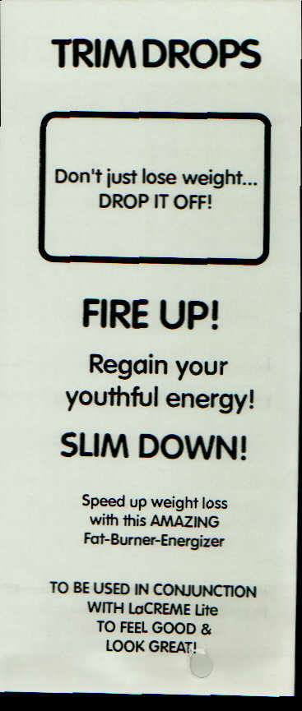
產品與服務
Products & Services
Trim Drops

Slide 18

產品與服務
Products & Services
Xtend Car Care

Slide 19
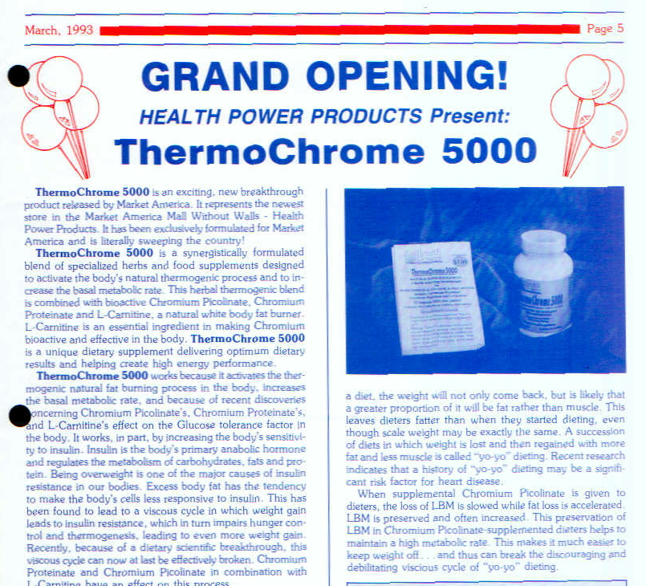
動力不斷提升
Momentum is Building
新產品 - Thermochrome
New Products - Thermochrome

Slide 20

舊有的已經煥然一新
What was old is NEW
舊的
Old
新的
NEW

Slide 21


舊有的已經煥然一新
What was old is NEW
舊的
Old
新的
NEW

Slide 22
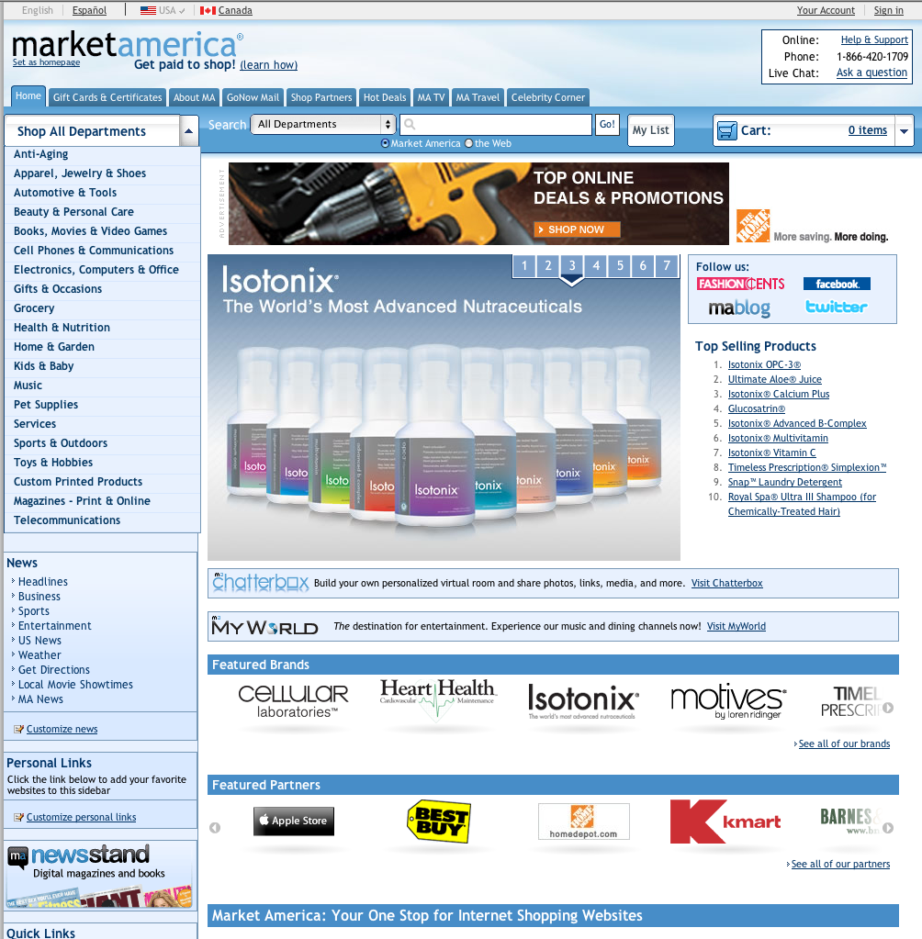
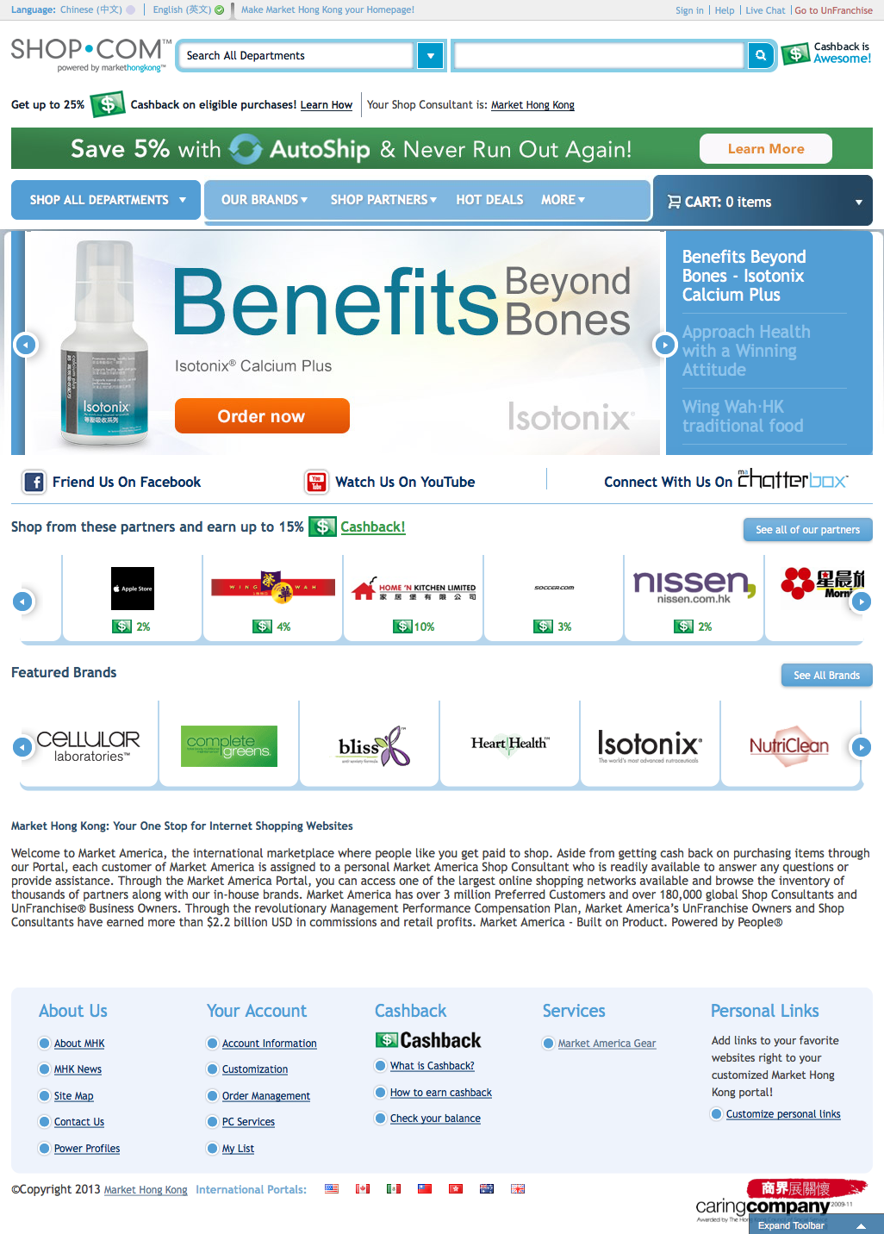
舊有的已經煥然一新
What was old is NEW
舊的
Old
新的
NEW

Slide 23
新的
NEW
新的
NEW
新的
NEW
新的
NEW
新的
NEW

Slide 24
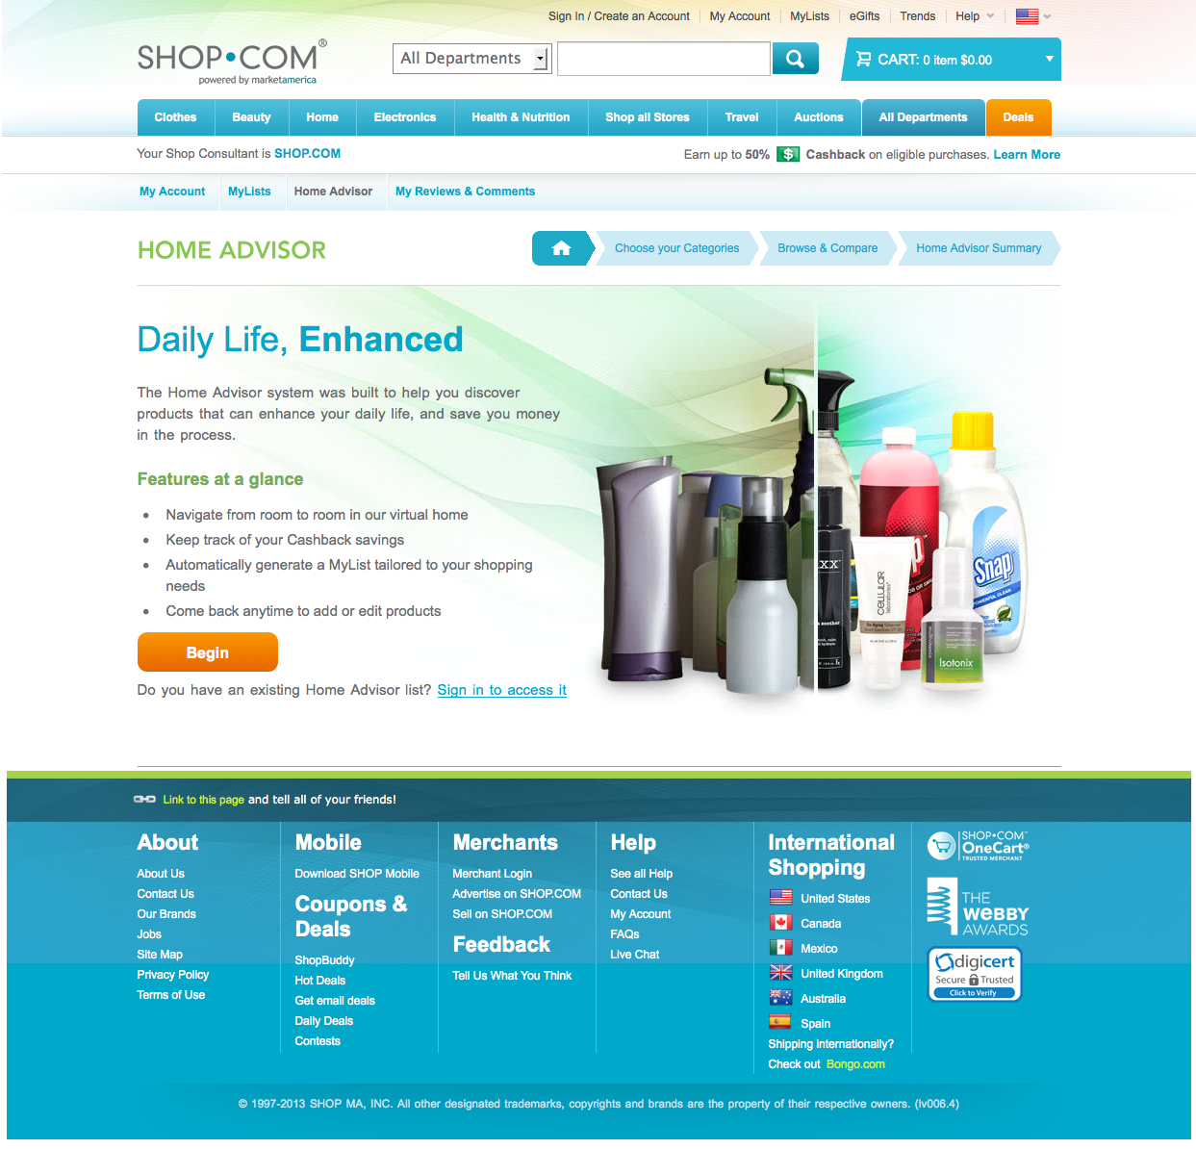

Slide 25
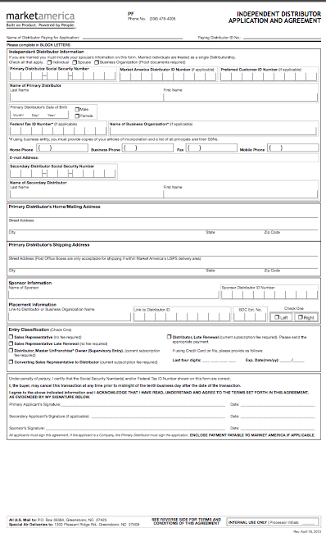
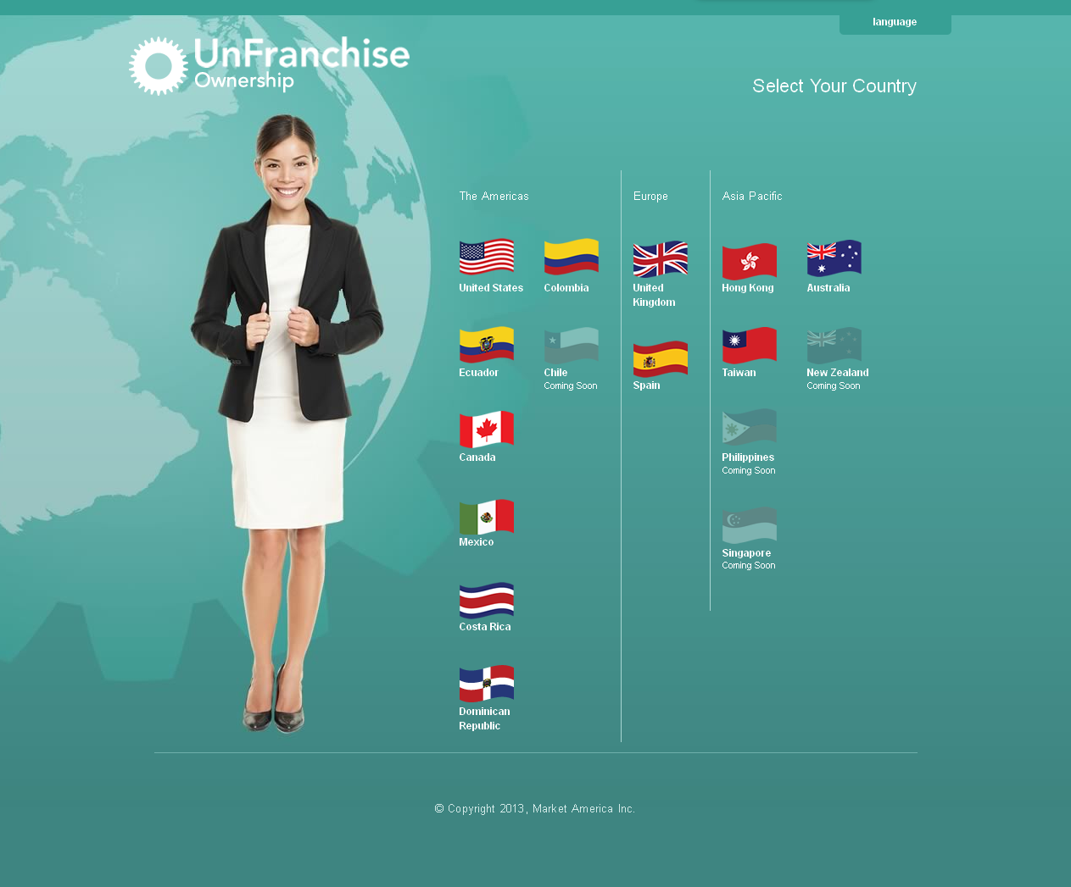
舊有的已經煥然一新
What was old is NEW
舊的Old
新的NEW

Slide 26

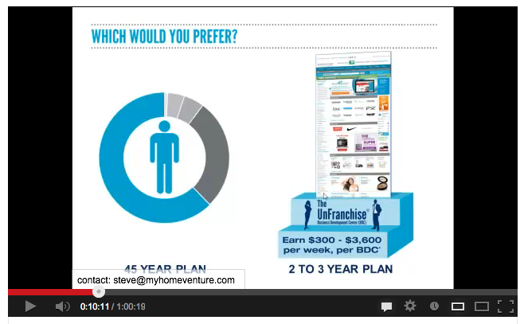


舊有的已經煥然一新
What was old is NEW
都是舊的
Still Old
舊的
Old
新的
NEW

Slide 27


Slide 28

Notes:
28
Financially Strong
Experienced Leadership
Proven Record of Success
Positioned for Explosive Growth

Slide 29


Slide 30


Slide 31


Slide 32
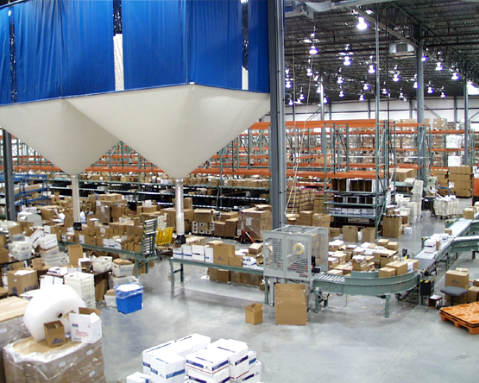
Notes:
32

Slide 33
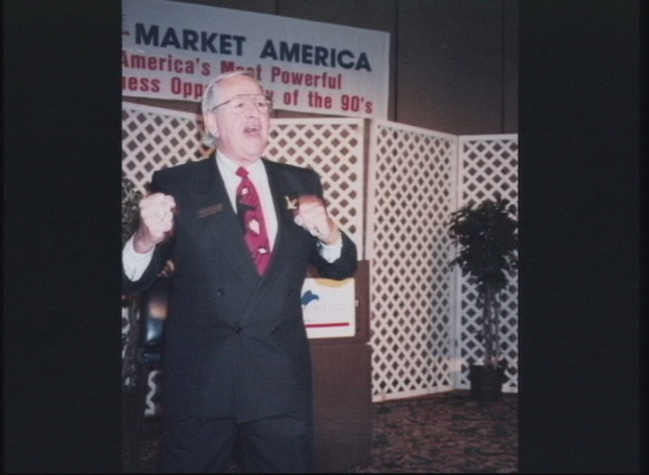
第一次年會
First Annual Convention

Slide 34
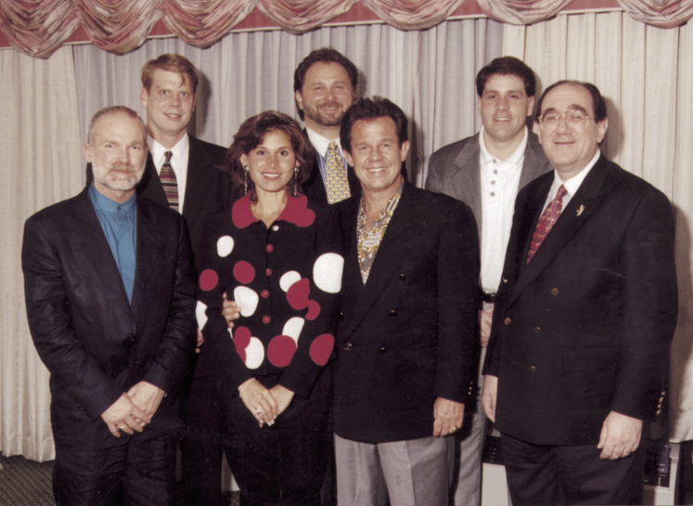
Notes:
Introduction
Exciting extraordinary new product for Market America
Share Vitarich background
Today I’m here to talk to you about Advanced CoQ₁₀™ , which is produced by Vitarich Laboratories, Inc. We know that consumers prefer to take their dietary supplements in a soft gel form. They’re easier to swallow, and as I’ll explain throughout this presentation, it is better absorbed than any other delivery system available.
If you have any questions during this presentation, I’ll be happy to answer them or get back to you with an answer.

Slide 35








Slide 36
大基石
CORNERSTONES
4
產品分銷 / 互聯網行銷
超連鎖事業系統
管理業績紅利計劃(MPCP)
一對一行銷及社交購物
Product Brokering / Internet Marketing
UnFranchise System
Management Performance Compensation
One-to-One Marketing & Social Shopping

Slide 37
物色新顧客 Identify New Customers
建立顧客佔有率 Build Share of Customer
產品分銷
Product Brokerage
顧客佔有率Customer Share
無限購物體驗與入門網站
Endless Shopping
Experience & Portal
無牆百貨
Mall without Walls
永續收入Residual Income
MPCP
BV
IBV
互聯網行銷與支援Internet Marketing & Support
超連鎖事業系統UnFranchise System
透明式訂製、數碼行銷及社交購物Transparent Customization, Digital Marketing & Social Shopping
優惠顧客
Preferred Customers
提供顧客想要的產品Provide Products Customers Want
一對一行銷
One-to-One Marketing
與更好的顧客合作
Work with Better Customers
Notes:
37

Slide 38
包括甚麼？
What’s Included?
$
垂直行銷
無需僱用人員運作
透過其他事業經營者擴大分銷
賺取永續收入
你透過分銷賺$
不會分薄他人利潤
每個SHOP.COM網站擁有人(UFO)享有：
顧客經篩選 + 受保障
顧客個人檔案、記錄、追蹤
顧客為UFO所有
使用所有後台辦公室功能
$
$
Vertical Marketing
Do not need employees to run
Expand distribution through other owners
Credited Residual Income
You make $ on Distribution thread
No reduction in profit to others
Each SHOP.COM Site owner (UFO)gets:
Customers are screened + Protected
Customer Profiles, Records, Tracking
UFO owns the customer
Complete back office access
$
$
$
$
$
$

Slide 39
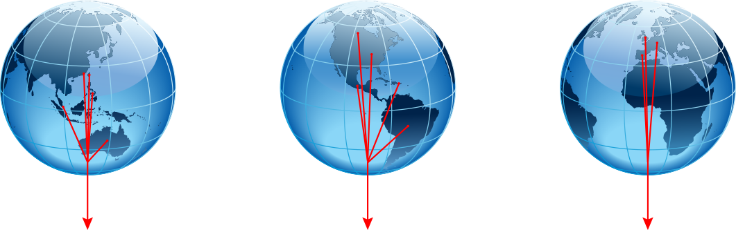
MPCP全球一體化 Global Unification of MPCP
3個綜合區域，以IRC和UGC連結區域
3 Unified Regions & Connecting Regions with IRC's & UGC's
亞太區ASIA REGION (UAP)
綜合BV/IBV庫
Unified BV/IBV Banks
美洲AMERICAS REGION (UAM)
綜合BV/IBV庫
Unified BV/IBV Banks
歐洲EUROPE REGION (UEU)
綜合BV/IBV庫
Unified BV/IBV Banks
第1步STEP
1
建立區域Build Regions
AUS TWN HKG PHI SIN NZL
USA CAN MEX SA EMP
GBR SPN OTHER
所有國家 – 1個MPCP
於一個BV/IBV庫綜合累積
All Countries – One MPCP
Combines & Accrues BV/IBV into one bank
所有國家 – 1個MPCP
於一個BV/IBV庫綜合累積
All Countries – One MPCP
Combines & Accrues BV/IBV into one bank
所有國家 – 1個MPCP
於一個BV/IBV庫綜合累積
All Countries – One MPCP
Combines & Accrues BV/IBV into one bank
跨區建立
Cross
Pollinate
轉介網絡
借力組織
轉介技巧
建立團隊
利用MeetOn.com與NMTSS
Zipper – 反向跨區建立
Network for Referrals
Leverage your Organization
Referral Technique
Create Teams
Use MeetOn.com & NMTSS
Zipper – Reverse Cross Pollination
轉介網絡
借力組織
轉介技巧
建立團隊
利用MeetOn.com與NMTSS
Zipper – 反向跨區建立
Network for Referrals
Leverage your Organization
Referral Technique
Create Teams
Use MeetOn.com & NMTSS
Zipper – Reverse Cross Pollination
轉介網絡
借力組織
轉介技巧
建立團隊
利用MeetOn.com與NMTSS
Zipper – 反向跨區建立
Network for Referrals
Leverage your Organization
Referral Technique
Create Teams
Use MeetOn.com & NMTSS
Zipper – Reverse Cross Pollination
BV/IBV= $
BV/IBV= $
BV/IBV= $

Slide 40
MPCP全球一體化 Global Unification of MPCP
3個綜合區域，以IRC和UGC連結區域
3 Unified Regions & Connecting Regions with IRC's & UGC's
亞太區ASIA REGION (UAP)
綜合BV/IBV庫
Unified BV/IBV Banks
美洲AMERICAS REGION (UAM)
綜合BV/IBV庫
Unified BV/IBV Banks
歐洲EUROPE REGION (UEU)
綜合BV/IBV庫
Unified BV/IBV Banks
第２步
STEP
2
之後
NEXT
下年
NEXT YEAR
現在NOW
向兩邊跨區建立Cross Pollinate
Both Directions
向兩邊跨區建立
Cross Pollinate Both Directions
向兩邊跨區建立Cross Pollinate
Both Directions
IRC和UGC連結區域，跨區建立
IRC's & UGC's
Connect Regions
Cross Pollinate
AUS TWN HKG PHI SIN NZL
USA CAN MEX SA EMP
GBR SPN OTHER
所有國家 – 1個MPCP
於一個BV/IBV庫綜合累積
All Countries – One MPCP
Combines & Accrues BV/IBV into one bank
所有國家 – 1個MPCP
於一個BV/IBV庫綜合累積
All Countries – One MPCP
Combines & Accrues BV/IBV into one bank
所有國家 – 1個MPCP
於一個BV/IBV庫綜合累積
All Countries – One MPCP
Combines & Accrues BV/IBV into one bank
轉介網絡
借力組織
轉介技巧
建立團隊
利用MeetOn.com與NMTSS
Zipper – 反向跨區建立
Network for Referrals
Leverage your Organization
Referral Technique
Create Teams
Use MeetOn.com & NMTSS
Zipper – Reverse Cross Pollination
轉介網絡
借力組織
轉介技巧
建立團隊
利用MeetOn.com與NMTSS
Zipper – 反向跨區建立
Network for Referrals
Leverage your Organization
Referral Technique
Create Teams
Use MeetOn.com & NMTSS
Zipper – Reverse Cross Pollination
轉介網絡
借力組織
轉介技巧
建立團隊
利用MeetOn.com與NMTSS
Zipper – 反向跨區建立
Network for Referrals
Leverage your Organization
Referral Technique
Create Teams
Use MeetOn.com & NMTSS
Zipper – Reverse Cross Pollination
BV/IBV= $
BV/IBV= $
BV/IBV= $

Slide 41
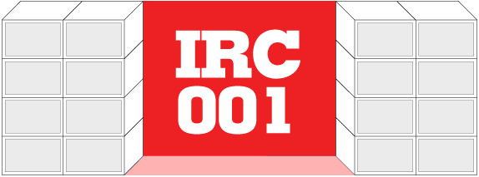
每個人都獲得一個IRC (國際再次加入中心)
Everyone is awarded an IRC (International Re-entry Center)
於你的超連鎖™事業帳戶進入IRC
Access IRC within your UnFranchise™ Business Account
Notes:
2ND OF 2 SLIDES SPLITTING PREVIOUS– ADDED TEXT

Slide 42

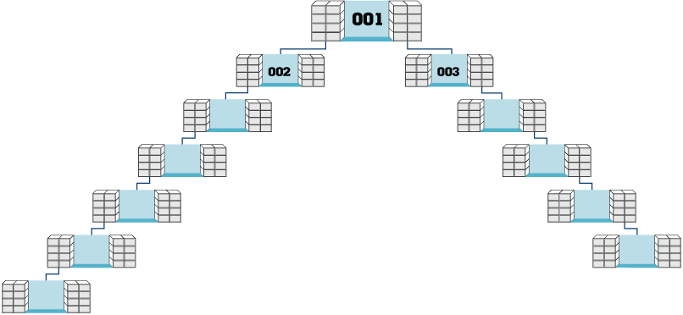
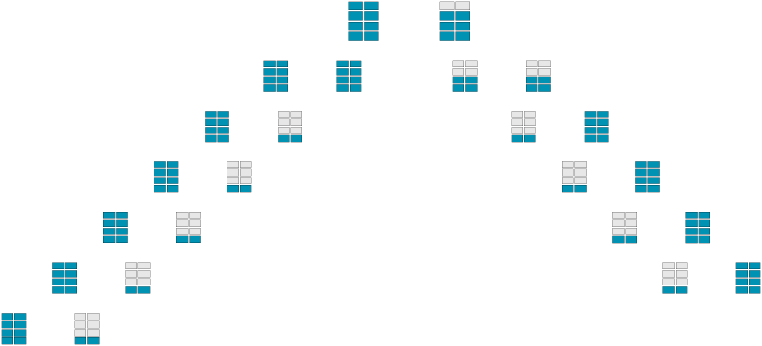



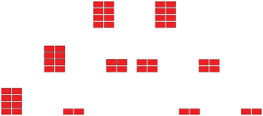
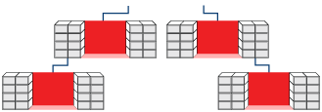
全球一體化管理業績紅利計劃
New Global Unified MPCP
美洲
The Americas
於連接至美洲本國較弱組織的接合點(IRC)，歐洲BV會轉化為美洲BV，並作為美洲BV向上累積。
The European (BV) volume converts to The Americas (BV) volume at the connection point (IRC) to your weak leg in the home country The Americas and accrues up as American volume.
歐洲
Europe
每週賺取佣金，發展你本國的商業發展中心(BDC)
Completes your home country BDC by earning commissions weekly
Notes:
Please check animation.

Slide 43


世界已變成
THE WORLD HAS GONE
數碼化
創業的人數前所未有的多
- 出生於嬰兒潮（出生率急升的時期）的人尋找另一個事業機會
- 人們有更大自由，並有更多需要
- Entrepreneurism is at an all-time high
- Baby Boomers are looking for a 2nd career
- People have more flexibility and need
Notes:
Job security, make more money, five times the average worker, personal development to maximize your human potential. The dream – freedom. Seven thousands baby boomers a day turn 65. working from home creates an opportunity for Plan B.
You can make it happen. It is not easy. It takes effort. And, in a sick way...it feels like pleasure. You have a impact on the community and economic growth. And, you become part of the solution.

Slide 44

新興市場計劃提供推介獎金
Emerging Market Program
Referral Bonus Offering..
全球網站Global.SHOP.com及美安品牌產品
Global.SHOP.com
and ma Branded Products

Slide 45
購物年金
SHOPPING
ANNUITY

Slide 46
創造美安購物年金
Creating A maShopping Annuity

Slide 47
創造美安購物年金
Creating A maShopping Annuity
美安公司的王牌產品是超連鎖事業發展系統
  系統讓有心創業的人士創造可觀永續收入，同時為全球消費者提供更好的購物方式
系統的核心是美安公司的管理業績紅利計劃(MPCP)；計劃就超連鎖店主(UFO)改變購買的產品和購物的方式為他們提供獎勵
Market America’s number one selling product is its UnFranchise Business Development System
  System for entrepreneurs to create a significant ongoing income, while providing consumers world wide with a better way to shop.
At the heart of this system is Market America’s Management Performance Compensation Plan (MPCP) that rewards each UnFranchise Owner (UFO) for changing what and how they shop.

Slide 48
創造美安購物年金
Creating A maShopping Annuity
創造美安購物年金由每位超連鎖店主(UFO)開始：
將現時每個月購買的家居用品品牌，轉為購買美安品牌產品
*UFO使用自己的美安品牌產品，可以「賺錢」(紅利/BV)
由現時每個月或定期到「店舖」購買的其他產品(衣服、電子產品、電器等)，變為在自己SHOP.COM網站上的相同商戶，以「點按訂購」的方式購買產品
*UFO透過shop.com/kcb (取代在www.bestbuy.com)購物，可以「賺錢」(現金回贈)
Creating a maShopping Annuity begins with each UFO:
Changing the brands of products they are currently buying for their households each and every month to ma-Branded products.
*UFOs get “PAID” (compensated/BV) for using their own maBranded Products
Changing how they buy all other products they are currently buying monthly or periodically (clothes, electronics, appliances, etc.) from “brick and mortar” establishments to “click and order” through their own SHOP.COM website from those same establishments.
*UFOs get “PAID” (cashback) to purchase through shop.com/kcb vs. www.bestbuy.com

Slide 49
創造美安購物年金
Creating A maShopping Annuity
  物色10-15個人做相同的事，並建立關係與顧客或未來事業夥伴(UFO)建立終身價值
*顧客購買美安品牌產品，可以「賺錢」(現金回贈)
*顧客透過shop.com/kcb購物，可以「賺錢」(現金回贈)
*顧客轉介其他顧客到shop.com/kcb購物，可以「賺錢」(現金回贈)
  物色2個或更多人，付出努力透過複製第1-4步改善財務狀況！
    *1% x 100 (團隊成員) vs. 100% x 1 (你)
  Identifying 10-15 individuals to do the exact same thing and build relationships to create lifetime value in customers or future business partners (UFOs).
*Customers get “PAID” (cashback) for purchasing maBranded products.
*Customers get “PAID” (cashback) for purchasing through shop.com/kcb.
* Customers get “PAID” (cashback) for referring Customers to shop.com/kcb to do the same.
  Identifying 2 or more individuals committed to improving their financial situation by duplicating 1-4!
    *1% x 100 (TEAM MEMBERS) vs. 100% x 1 (YOU)

Slide 50
創造美安購物年金
Creating A maShopping Annuity
結果是創造無限的BV和IBV，這些就是MPCP的命脈。每個UFO的目標是成為「購物顧問」
令自己和顧客享受最快捷有效率的家居購物體驗！
The result is the creation of a never-ending flow of BV and IBV, which is the lifeblood of the MPCP. Each UFO’s objective is to become a “Shop Consultant”.
Making the shopping experience for their household and the households of their customers as efficient as possible!

Slide 51
創造美安購物年金
Creating A maShopping Annuity
「年金」的概念，就是你於指定時期內，每隔指定的時間獲發固定款項
要累積「年金」，你必須先作出固定供款，才有機會獲發金錢
美安公司的「購物年金」以相同方式運作，但有一個重大分別
UFO作出的固定供款並不是金錢，而時時間
An “annuity” is a process by which a fixed payment is made to you at specified intervals for a specified length of time.
To fund the “annuity” you must contribute a fixed sum payment before payouts to you may begin.
Market America’s “Shopping Annuity” works the same way with one major difference.
A UFO’s specified fixed sum payment made is not in legal tender, but in time.

Slide 52
創造美安購物年金
Creating A maShopping Annuity
每星期投入8-15小時，持續24-36個月，你就可創造「固定供款」
進行上述四項活動，確保你兩個銷售與分銷組織內的所有事業夥伴進行複製
你可以合理預期，每星期收取最少$1500…持續地！
By investing 8-15 hours per week for 24-36 months you create your “fixed sum payment”.
Performing the four activities above and ensuring all business partners within your two sales and distribution organizations duplicate.
You can reasonably expect to receive at least $1500 per week…forever!

Slide 53
創造美安購物年金
Creating A maShopping Annuity
由家居檢查開始：
  調查(點算存貨)你每月和每季消費或購物的家居用品
  了解有多少產品可讓你建立購物年金，轉消費為利潤！
    利用美安家居購物清單
    很快推出虛擬產品顧問
    由你開始，然後與每位事業夥伴進行，並於整個團隊的顧客基礎中複製
Starts with Household Assessment:
  Surveying (taking inventory) of what you spend or buy monthly and quarterly.
  Discover how many things you could use to fund your shopping annuity and simply convert SPENDING INTO EARNING!
    Use ma HSL
    Soon Virtual Product Consultant
    Starts with YOU, then conduct with each business partner and duplicate with your entire organization’s Customer Base

Slide 54
逐步邁進
STARTING THE CLIMB
購物年金計劃
Shopping Annuity Plan
團隊複製
約定夥伴進行家居檢查
Duplicate in Group
Assessment Appointments
10
9
轉介→ Shop Points計劃
Referrals → Shop Points
8
7
自動送貨
Auto Ship
6
優惠顧客-協助他們
PC’s – do them a favor
5
4
由購物車產生訂單
Generates Order From Cart
3
我的清單
My List
2
家居購物清單
Home Shopping List
1
家居顧問
Home Advisor
家居檢查
Assessment

Slide 55
你的目標與策略目標
Your Goal & Strategic Objectives
目標：
建立兩個銷售與分銷組織，產生每週5000以上團體業績點數(GBV) – 產生(美元) $2100；(台幣) $66,500；(澳元) $2,100；(港幣) $16,100或(英鎊) £1190.
策略目標：
透過建立優惠顧客銷售產品 - (你最好的顧客)
    產品代言人
    購物年金
Goal:
Build two sales and distribution organizations that generate in excess of 5000 Group Business Volume per week – resulting in (US)$2100; (NT)$66,500; (AUS) $2,100; (HK)$16,100; or (UK)£1190.
Objective:
Sell products by developing Preferred Customers - (your best customers)
    Product of The Product
    Shopping Annuity

Slide 56
你的主要目標
Your Main Objectives
目標：
宣傳事業或讓更多人認識超連鎖事業發展系統
目標：
銷售門票 – 將舉行的會議聯盟系統(NMTSS)活動
Objective:
Sell The Business or expose the UnFranchise® Business Development System
Objective:
Sell tickets to upcoming NMTSS events (National Meeting Training Seminar System)

Slide 57

建立事業 Building Your Business
時間分配 BREAKDOWN OF TIME
80%
- 產生效益的活動
- 銷售產品
- 宣傳事業
- 賣票
- Result Producing Activities
- Sell Product
- Sell The Business
- Sell Tickets to NMTSS
Notes:
Assuming working 15 hours a week, 80% equates to 12 hours.

Slide 58

建立事業 Building Your Business
時間分配 BREAKDOWN OF TIME
15%
- 支持活動
- 提高個人執行有效益工作的能力
- 潛在的陷阱
Support Activities
To enhance one’s ability to perform
the results producing activities
- The Potential Trap
Notes:
Working 15 hours a week, 15% of the time equates to 2 hours.

Slide 59

建立事業 Building Your Business
時間分配 BREAKDOWN OF TIME
5%
- 文書行政工作
- 完成公司要求的行政工作
- 記錄你的事業活動
- Housekeeping Activities
Completing required administrative
tasks
- Documenting your business activities
Notes:
Working 15 hours a week, working 5% of your time equals 1 hour.

Slide 60


你的事業優勢
Your Strategic Advantage…
緊貼趨勢的事業模式...人們喜歡購物
產品分銷...顧客購物量與顧客佔有率
有系統及結構...複製與增長
盈利能力及穩定性...零售利潤與永續收入
可傳承的事業
Dynamic Business Model...people love to buy.
Product Brokerage...customer share & share of customer.
Systemization and Structure...duplication & growth.
Profitability and Stability...retail profit & residual income.
Business that can be passed on.

Slide 61

正確地方...
適當時機...
對的計劃...
就是這個機會！
The Right Place...
The Right Time...
The Right Plan...
THE RIGHT OPPORTUNITY!

Slide 62

嶄新的你！
A
New
YOU!
Notes:
62

Slide 63
更精明地工作，並於做每一件工作、行動和努力時再付出多一點… 結果就會有很大分別
這是想得到正面結果和超凡回報的分別！
於我們事業與人生各方面額外付出一點努力，足以成就世界上的種種分別！
Working smarter AND just a LITTLE harder in every task, action and effort we undertake… means a big difference in the results we get.
It is the difference between obtaining positive results or Extraordinary Rewards!
Just a little extra effort in every aspect of our business and our lives will make all the difference in the world!
Notes:
63

Slide 64
看來人人都想要「萬無一失」或「快速的」解決辦法
我們已經、正在，並將會撰寫/製造/製作大量資料，介紹付出少許或無需付出努力就可達到成果的方法！
這麼有效….賣廣告嗎？
很多時候，你付出更多努力，為的是避免付出額外努力！
It seems everyone is looking for the “Silver Bullet”, “MagicDust”, or the “Quick Fix”
Enormous amounts of material have been, are being, AND will be written/produced/created promoting methods for achieving end results with little or no Effort!
So effective….advertising?
Many cases you work harder to avoid the extra effort than applying it!

Slide 65
已撰寫/製造/製作的資料… 推廣有效的方法
可惜的是… 缺少了讀者/觀眾/學員的行動/努力！
實際行動的人當中,有部份付出額外努力，去達到想要的效果
購買了書籍、出席了活動… 就今天一樣具有正面目的… 最後出席者只欠缺熱情地花費了些時間… 會得出相應結果！
Great material… written / produced / created promoting solid approaches.
Unfortunately… ACTION / EFFORT by reader / viewer / student is the missing ingredient!
For those who DO take action, there is a fraction who apply the EXTRA EFFORT necessary to reach intended result.
Books purchased, programs attended… LIKE THIS ONE
  with wonderful intentions… only to end in another block of time invested half-heartedly… with corresponding results!
Notes:
65

Slide 66
為何你參加活動，卻偏偏欠缺對達成目標的承擔？
不是對達成目標的渴望，而是對達成目標的承擔！
WHY do you enter into any activity with anything but a COMMITMENT to achieve your objective?
Not a desire to achieve but a COMMITMENT TO ACHIEVE!
Notes:
66

Slide 67
你需要跨過去！
We need to CROSS THE LINE!
越過：(動詞)
Cross: (verb)
從一邊到另一邊
越過平庸
to move from one side to another
to pass over mediocrity
Notes:
67

Slide 68
每件事都有一條界線
  其中一邊好事發生的機會較大，在這邊你會找到欣賞的事物
  另一邊… 機會少之又少
每條界線之前，都涉及選擇
你想跨過去，還是不想？！
你爭取成就，還是妥協接受…
WITH EVERYTHING, there is a line.
  On one side there is a greater chance to make good things happen. This is where you find those that you admire.
  On the other side… there is much less of a chance
With each line, there is a choice
YOU WANT TO cross the line or YOU DON’T!
You achieve or you settle…

Slide 69
一切是
你的
選擇
IT IS
YOUR
choice
Notes:
69

Slide 70
2-3年 vs 45年計劃
2-3 YEARS vs. 45-YEAR PLAN
放遠視野！PERSPECTIVE!
12個月
6個月
3個月
2個月
1個月
2星期
1星期
24個月
12 Months 1500
6 Months 1500
3 Months 1500
2 Months 1500
1 Month 1500
2 Weeks 1500
1 Week 1500
24 Months = $10,500
25 -36個月，每星期最少$1500
每年收入78,000 – 187,000
25 -36 months @ $1500/
week minimum
78,000 – 187,000 of
Yearly Ongoing
Income

Slide 71
萬無一失、快速的解決辦法…
Silver Bullet Magic Dust…
做我們一直在做的事，需要時間、努力和能量
不如從這些時間、努力和能量抽出一部份，做一些不同的事，去創造不同的結果！
Doing what we have always done, takes time and effort and energy.
Let’s use a portion of that same time, effort, and energy to do something different in order to obtain something different!

Slide 72
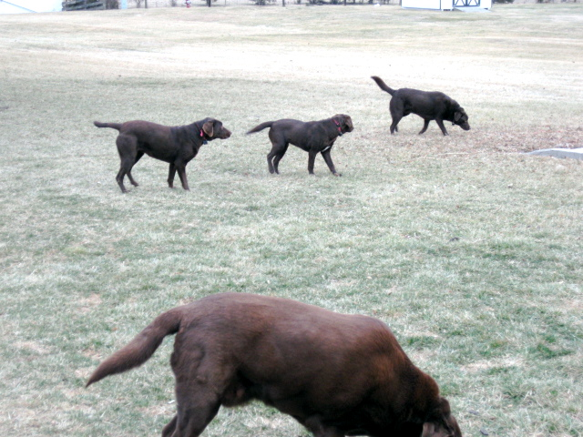
Notes:
72

Slide 73
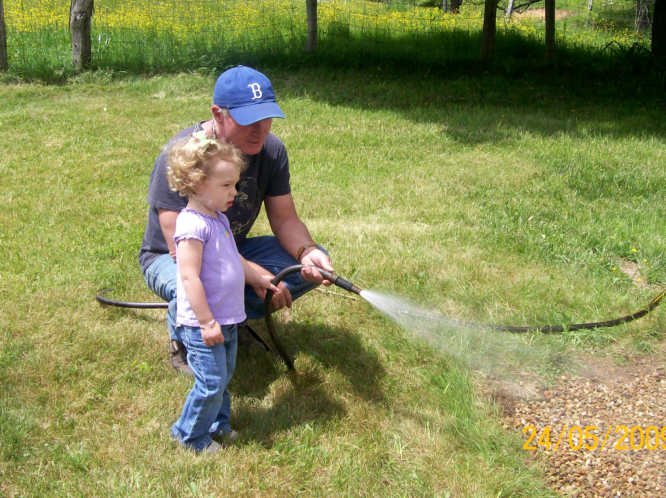
Notes:
73

Slide 74
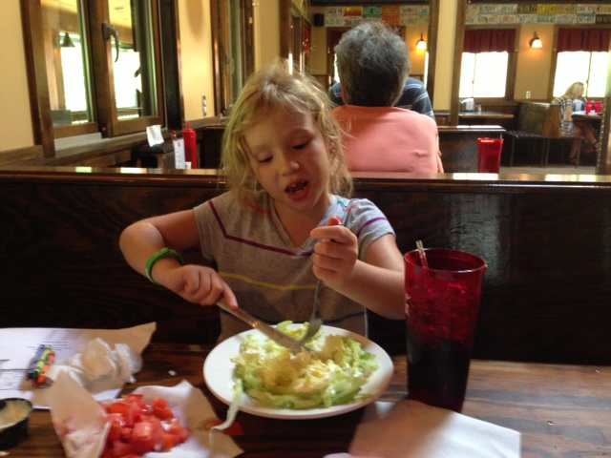

Slide 75


Slide 76

Notes:
76

Slide 77
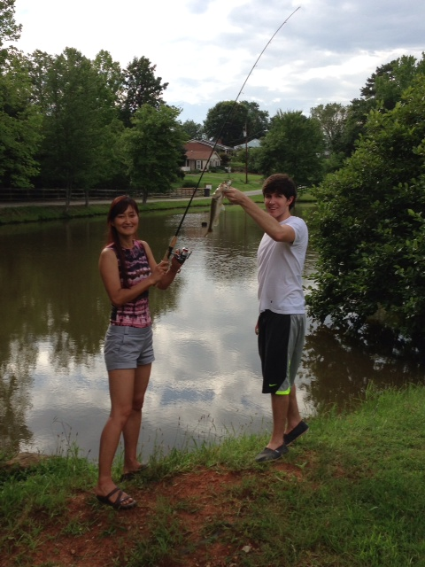

Slide 78
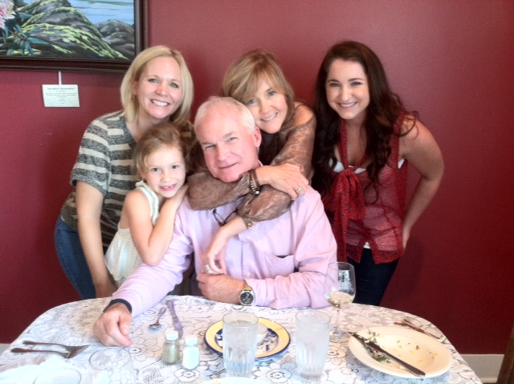

Slide 79
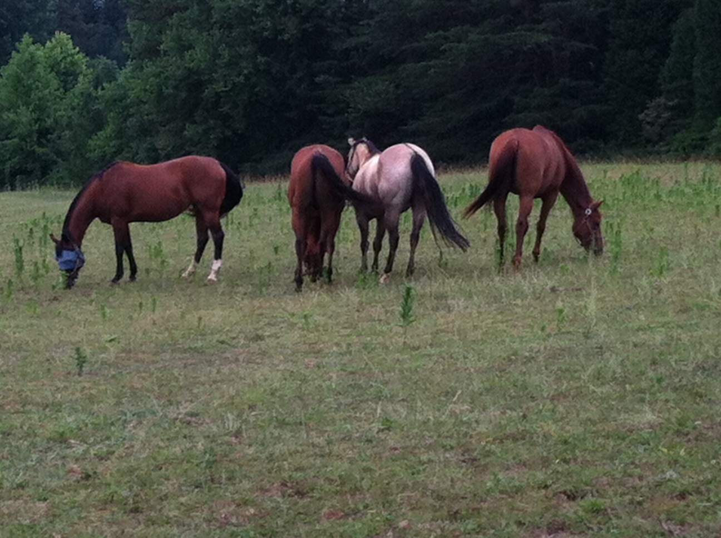

Slide 80


Slide 81
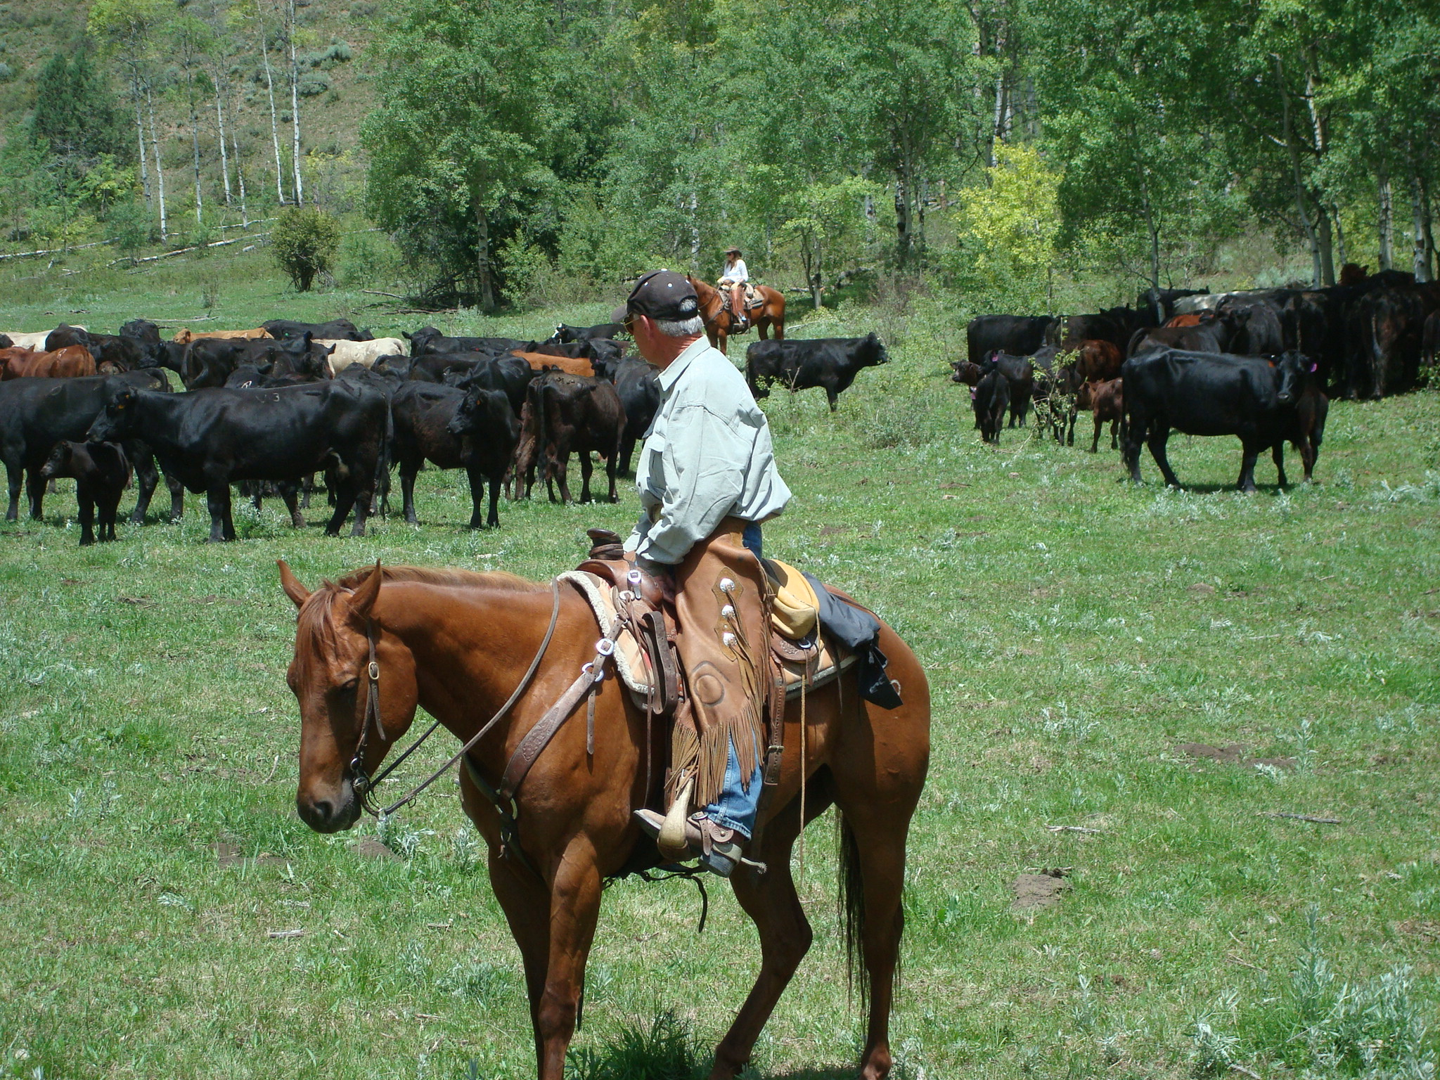
Notes:
81

Slide 82


Slide 83



Slide 84

Notes:
84

Slide 85

Notes:
85

Slide 86

Notes:
86

Slide 87


Slide 88


Slide 89


Slide 90


Slide 91


Slide 92


Slide 94
萬無一失、快速的解決辦法
SILVER BULLET MAGIC DUST…
不是向你 “賣夢想”
你擁經有的,不能賣給你
專注做達成夢想所需的事
Not trying to sell you a dream.
Can’t sell you something you already own.
Focused on what it takes to deliver your dreams.

Slide 95
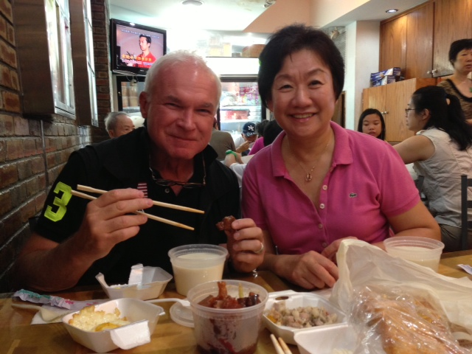

Slide 96
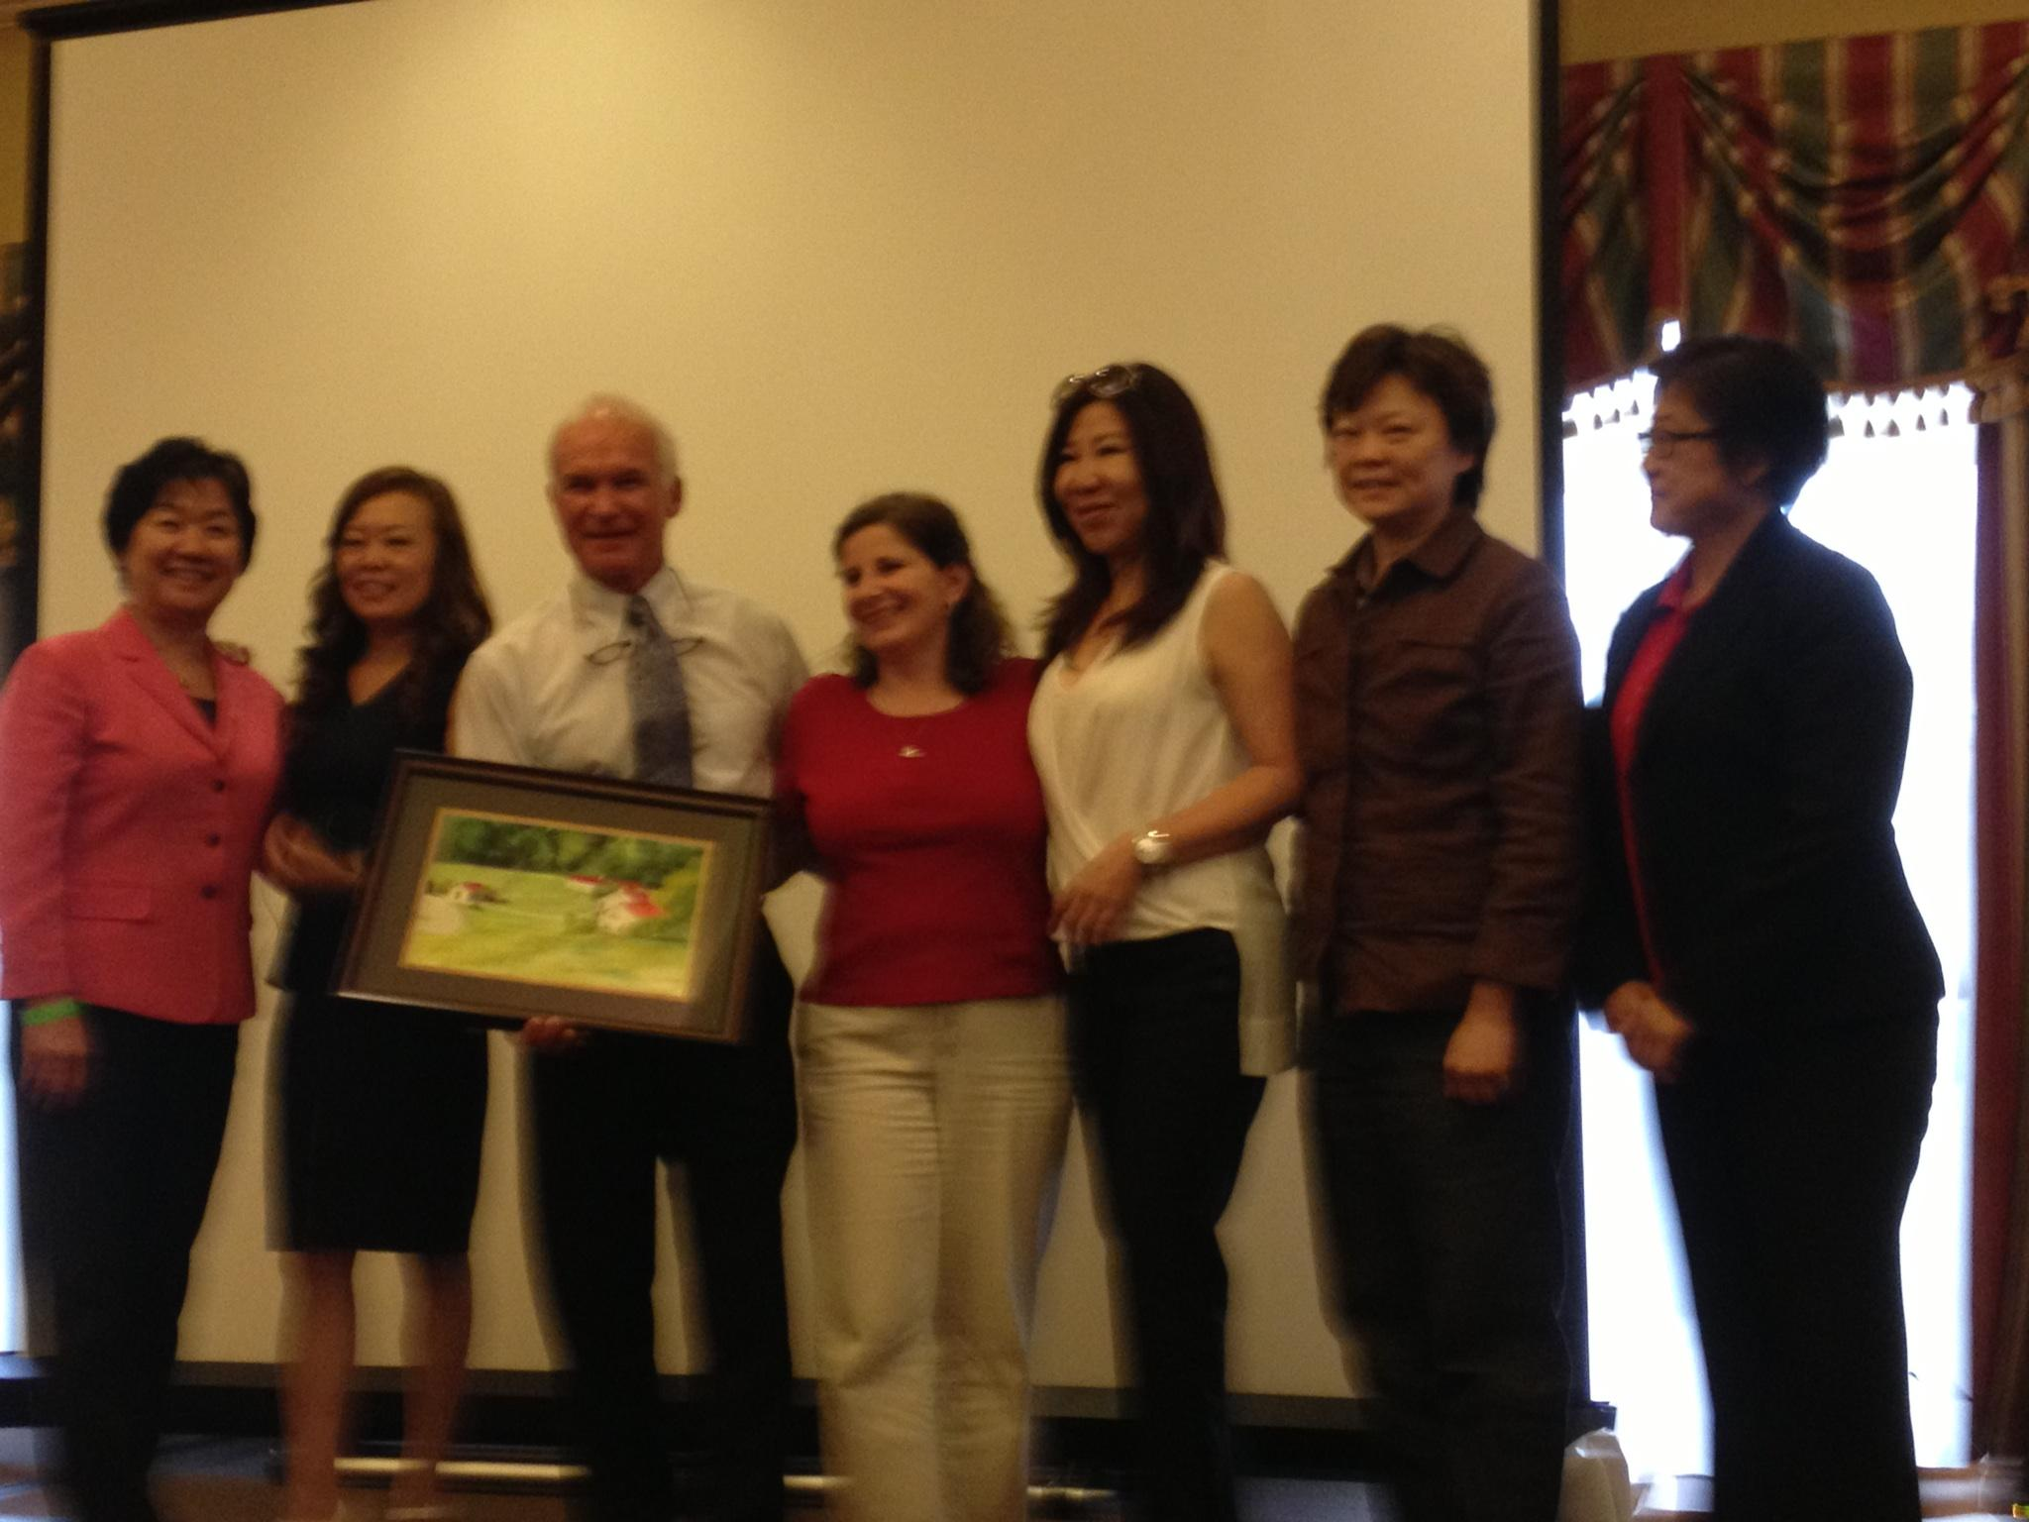

Slide 97


Slide 98


